Slide 1
CHAPTER 4 (PART I): INTELLECTUAL PROPERTY
TS. DR. ROZI NOR HAIZAN
BINTI NOR

Slide 2
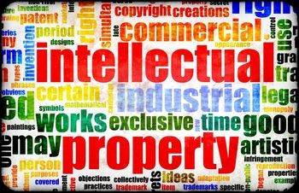
Objectives
What is IP and how new technologies
affect IP
How should IP be protected
Copyright law
Free software
Issues for software
developers

Slide 3
Introduction
Digital music storage + Internet --> crisis
Value of intellectual properties much greater than value of media
Creating first copy is costly
Duplicates cost almost nothing
Illegal copying pervasive
In light of information technologies, how should we treat IP?

Slide 4
Definition - IP
Any unique product of the human intellect that has commercial value
Intangible creative work – not necessarily the physical form on which it is stored or delivered
Books, songs, movies
Paintings, drawings
Inventions, chemical formulas, computer programs
IP = physical manifestafion

Slide 5
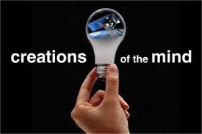
Intellectual Property
Intellectual property includes works of the mind such as art, books, films, formulae, inventions, music, and processes that are unique and that are “owned” or created by a single entity.

Slide 6
Analogy is Imperfect
If two people write same play, both cannot own it
- every IP is one-of-a-kind
If one person “takes” another's play, both have it
- copying an IP is different from stealing a physical object

Slide 7
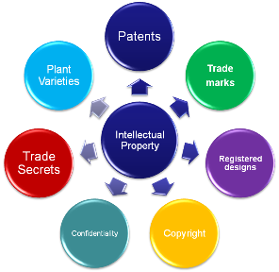
Legal Protection
IPs are given in the form of:
Trade secret
Patents
Trademark
copyright

Slide 8
Why Legal Protection?
The value of IP comes from the creativity, ideas, research, skills, labour, and other nonmaterial effort and attributes provided by the creators
A property right is a type of 'natural right' that should be granted
Property rights are social contracts designed to encourage creators and inventors to better serve society

Slide 9
Benefits of IP Protection
New ideas in the form of inventions and artistic works can improve the quality of life
Some people are altruistic and glad to share with others; some are not
attraction of wealth can be the incentive to produce something useful
If a person has a right to control the distribution and use of a piece of IP, there are opportunities to make money
Government recognized benefits to limited intellectual property protection

Slide 10
Limits to IP Protection
Giving inventors rights to their inventions stimulates creativity
Society benefits most when inventions in public domain
Inventors or authors are given rights for a limited time

Slide 11
Protecting IP – Trade Secrets
The Uniform Trade Secrets Act (UTSA) defines a trade secret as “information, including a formula, pattern, compilation, program, device, method, technique, or process that:
Derives independent economic value, actual or potential, from not being generally known to, and not being readily ascertainable by persons who can obtain economic value from its disclosure or use
Is the subject of efforts that are reasonable under the circumstances to maintain its secrecy

Slide 12
Protecting IP – Trade Secrets
Confidential piece of IP that gives company a competitive advantage
Never expires
Not appropriate for all IP
May be compromised when employees leave firm

Slide 13
Trade Secrets
Reverse Engineering Allowed
Reverse engineering is the process of breaking something down in order to understand it, build a copy of it, or improve it.

Slide 14
Trade Secret
To qualify as a trade secret, the secret must have
Economic value
Must not be readily ascertainable
The trade secret owner must take steps to maintain its secrecy

Slide 15
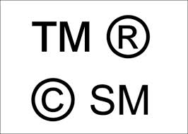
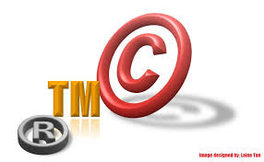
Protecting IP – Trademark, Service Mark
Trademark : identifies goods
Service mark : identifies services
Company can establish a “brand name”
Does not expire
If brand name becomes common noun, trademark may be lost

Slide 16
A trademark is anything that enables a consumer to differentiate one company’s products from another
TRADEMARK is something you can do to brands. If you trademark a brand, then you own the "intellectual property" of that brand and you are the only person allowed to use that Brand name, slogan etc. If others want to use that brand, they must ask your permission or pay some money.

Slide 17
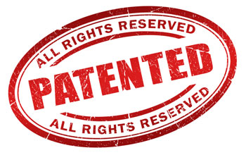
Protecting IP - Patent
A public document that provides detailed description of invention
Provides owner with exclusive right to the invention
Owner can prevent others from making, using, or selling invention for certain amount of years

Slide 18
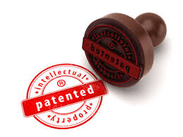
Patents
A patent enables the inventor to take legal action against those who, without the inventor’s permission, manufacture, use or sell the invention during the period of time the patent is in force.
The United States Patent and Trademark Office reviews patent applications and issues patents to approved inventions

Slide 19
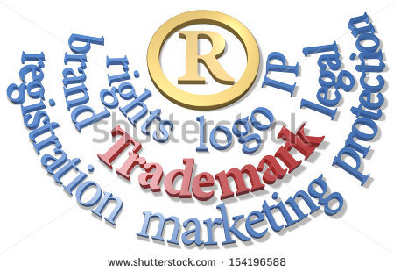
Copyright
Provides owner of an original work five rights
Make copies of the work
Distribute copies
Produce derivative works
Perform the work in the public
Display the work in the public

Slide 20
Problems from New Technologies
High-quality copying
High-quality distribution
Easier to use
Less expensive

Slide 21
Problems from New Technologies – technological factors
Storage of all sorts of information in standard digitized formats
High-volume, relatively inexpensive digital storage media (hard disks, CDROMs, DVD, thumb drive)
Compression formats (MP3) make music and movie files small enough to download, copy, and store
Character scanners and image scanners convert printed text, photos, and artwok to digitized forms

Slide 22
Problems from New Technologies – technological factors
The ease of “perfect” copying digitized material
The ease of distributing digitized material over computer networks
WWW makes it easy to find and download material
Peer-to-peer technology permits easy transfer of files by large numbers of strangers over the internet without any centralized system or service

Slide 23
Copyright Act 1987
Protects copyright in Malaysia
Provides characteristics of copyright material, scope of protection, and ways this protection will be given
Provides clauses on enforcement

Slide 24
History of Copyright in Malaysia
1911 : enforcement of Copyright Act (UK) for Penang and Melaka
1930s : Copyright Enactment was used in Negeri Melayu Bersekutu.
1957 : Copyright Act 1911 and Copyright Enactment
1963 : Copyright Act 1956(UK) was a part of copyright laws in malaysia
1969 : Copyright Act 1969 was used replacing the earlier act
1987 : review of Copyright Act (1969) and used as Copyright Act (1987)
1990 : amendment to Copyright Act (1987)
Until now there are amendments to Copyright Act (1987)

Slide 25
Conditions for Copyright Protection
The work must be in one of the types mentioned in Copyright Act (1987)
The work must be original
The work should be fixed in material form

Slide 26
Conditions for Copyright Protection
The inventor of the work should be qualified:-
- citizen or permanent resident
- firstly produced in Malaysia
- made in Malaysia
- made by or under the control of Malaysian government
- citizen or permanent resident of a country in Treaty or Convention

Slide 27
Copyright Infringement
Direct Infringement
- unauthorized person performs the exclusive rights of the owner
Indirect Infringement
- importing an infringed article from oversea for commercial without an agreement from the owner of the original copy, for example, if your brother has made infringing copies of a CD, and you know these copies are infringing and help create an e-bay listing for your brother to sell the discs, you have committed indirect infringement.
Infringement through overriding of effective technology step
- anyone does or makes others to do overriding to whatever technological steps used by the owner

Slide 28
Copyright Infringement
Infringement through alteration or deletion of electronic right management
- the act of altering or deleting information on electronic right management without agreement from the owner
Electronic Right Management (ERM) technologies attempt to control what you can and can't do with the media and hardware you've purchased.

Slide 29
Fair Use Concept
Sometimes legal to reproduce a copyrighted work without permission
- allows uses of copyrighted material that contribute to the creation of new work and do not significantly affect sales of the material
- allows some research and educational uses as well as news reporting and critiquing
- however for public use, there should be an acknowledgement to the owner

Slide 30
Fair Use Concept
Courts consider four factors
Purpose and character of use
- an educational use is more likely to be permissible than a commercial use
Nature of work
- use of non-fiction is more likely to be permissible than use of fiction. Published works are preferred over unpublished works

Slide 31
Fair Use Concept – cont..
Courts consider four factors
Amount of work being copied
- brief excerpts are more likely to be permissible than entire chapters
Affect on market for work
- use of out-of-print material is more likely to be permissible than use of a readily available work.

Slide 32
Fair Use : example 1
A professor puts a few journal articles on reserve in the library and makes them assigned reading for the class. Some students in the class complain that cannot get access to the articles because other students always seem to have them checked out. The professor scans them and posts them on his web site. The professor gives the students in the class the password they need to access the articles.

Slide 33
Fair Use : example 1
First factor : the purpose of the use
The purpose is strictly educational; hence this factor weighs in favor of fair use
Second factor : the nature of work
the journal articles are nonfiction. This weighs in favor of fair use
Third factor : the amount of material
The fact that the professor is copying entire articles rather than brief excerpts weighs against a ruling of fair use

Slide 34
Fair Use : example 1
fourth factor : effect on the market for journal sales
If the journal issues containing these articles are no longer for sale, then the professor’s action cannot affect the market.
The professor took care to prevent people outside the class from accessing the articles.
Overall, this factor appears to weigh in favor of fair use
Three out of four factors weigh in favor of fair use

Slide 35
Fair-Use Cases
Sony vs Universal City Studios
Sony introduces Betamax VCR (1975)
People start time shifting TV shows
Movie studios sue Sony for copyright infringements
US supreme court evaluated the case in light of the four fair use factors

Slide 36
Fair-Use Cases
First factor: intended purpose of the copying
Purpose is private, not commercial, time shifting should be seen as fair use
Second factor : nature of the copied work
Consumers who are time shifting are copying creative work. this would tend to weigh against a ruling of fair use
Third factor : amount of material copied
Since a consumer copies the entire work, this weighs against a ruling of fair use

Slide 37
Fair-Use Cases
Fourth factor : the affect time shifting will have on the market
The studios were unable to demonstrate that time shifting had eroded the commercial value
The movie studios receive large fees from television stations in return for allowing their movies to be broadcast
Television stations can pay these large fees because they receive income from advertisers
Advertising rates depend upon the size of the audience

Slide 38
Fair-Use Cases
Fourth factor : the affect time shifting will have on the market
The larger the audience, the more a television station can charge an advertiser
Time shifting allows people to watch a show later
Hence VCR can actually increase the size of audience, since the audience size determines the fees studios receive to have their movies broadcast, it is not at all clear whether copying harms the studios
Supreme court ruled (5-4) that time shifting is a fair use

Slide 39
Fair-Use Cases
Diamond introduces Rio (1998)
People start shifting their music
RIAA starts legal action against Diamond for violation of the Audio Home Recording Act
US court of appeal, 9th circuit, affirms that space shifting is consistent with copyright law

Slide 40
Fair-Use Cases
Sega Enterprises Ltd vs Accolade Inc
1992: reverse engineering a complete program in order to produce new, creative work was ruled fair use

Slide 41
Copying Music
Improved technology allows for easy, fast, cheap, and ubiquitous copying on the web
Entrepreneurs create businesses to facilitate storing and sharing of music files.
Many individuals set up free sites for music sharing
Recording industry continues to fight unauthorized copying of music

Slide 42
Copying Movies and TV programs
Improved digital technologies and greater bandwidth on the net also allows for copying and transferring of movies and tv programs
Business such as RecocdTV.com and Scour provided free services to facilitate copying of broadcast intellectual material
Entertainment companies continue to fight unauthorized copying of their IP

Slide 43
Copying Books
Improved technology allows for simple, quick, and cheap copying of books
Counterfeiters of textbooks, novel, and other printed matter, profit by not paying publishers and/or authors for their IP
Electronic books use encryption to reduce copying, but some e-book protection schemes have been cracked

Slide 44
Copying software
Improved digital technologies contribute to unauthorized (commercial and non-commercial) copying of software
Individuals and whole businesses, continue to produce, transport, and sell (or give away) copies of software, manuals and supporting material
Software industry organizations and companies battle software piracy

Slide 45
The Napster Case
Benefits of Napster (aside from being free):
Share music with other users;obtain individual sonds from a CD; sample songs on a CD; access more songs; access commercially unavailable sonds;
Legal issues:
Was copying and distributing music through Napster within fair-use guidelines? If not, was Napster responsible for their actions?
Court decision:Napster was guilty of encouraging and assisting copyright infringement

Slide 46
Protection for Software
What is exactly copyrighted software?
Copyright protects the expression of idea. Eg, implementation of a relational DBMS; not the concept of using relational database to store information
Usually protect the object (executable) program, not the source program
Typically the source code to a program is confidential which is a trade secret
Protects the screen displays produced by the program as it executes

Slide 47
Software Piracy – violation of software copyright
The act of theft through copying software, use or distribute software product without authorization
Copying of software ( and documentation) to give or sell
Illegal copying business or organization for their own use
Distribution of software over the internet
Preloading software onto the hard disk of a computer being sold
Intentionally put copyrighted software on web sites for others to download

Slide 48
Software Piracy – violation of software copyright
Counterfeiting – to produce, transport, and sell copies of the disks, documentation, and sometimes identical packaging for popular business and personal computer software
Counterfeiting software are sold at lower prices but they profit because they do not pay designers,developers, programmers, managers etc

Slide 49
Software Piracy – violation of software copyright
Why occurs?
Copying is easy
Lack of awareness about copyright act
Lack of government enforcement
Do not understand the benefits of original software
Lack of recognition for IP
Greedy and careless
High demand from users
Problem with cash flow
Problem with bribery

Slide 50
Software Piracy – violation of software copyright
Effect of piracy
Reduces competitiveness in software industry
Reduces investment in new development of software
Users who are using pirated software do not get technical support, assurance, and update
Risk of being affected by virus, un-functional, incompatible with hardware
Increase in software cost
Reduces software development

Slide 51
Morality of copying software
Is it right to copy proprietary software?
If you violate a licensing agreement, you are breaking the law
What is the morality of breaking the law?

Slide 52
Social contract theory
Assumption : everyone in society ought to bear certain burdens in order to receive certain benefits
Legal system: to guarantee that people’s rights are protected
Guarantees people will not choose their selfish interests over the common good
Thus we have prima facie obligation to obey the law.
Therefore, it is wrong to copy software, because copying violates the legal rights of the person or organization owning the copyright.

Slide 53
Arguments in support personal copying and counterpoints
I cannot afford to buy the product
There are many things we cannot afford; not being able to afford something is not an excuse for taking it
The company is large, wealthy corporation
The size and success of the company do not justify taking from it. Programmers and writers lose income too when copying is common
Making a copy for a friend is just an act of generosity
Surely we have a liberty to be generous, and we can exercise it by buying a copy of the program for the friend

Slide 54
Arguments in support personal copying and counterpoints
This violation is insignificant compared to the billion of dollars lost to piracy by dishonest resellers making big profit
Yes, large-scale commercial piracy is worse. That does not imply individual copying is ethical. And, if the practice is widespread, the losses become significant
Everyone does it. You would be foolish not to
The number of people doing something does not determine whether it is right.

Slide 55
Fair use – group discussion
An art lecturer takes slide photographs of a number of paintings reproduced in a book about Renaissance artists. She uses the slides in her class lectures
You have scanned the entire text of Md. Akhir Leman's novel "Bahagia Sesudah Derita" (1958) and placed it on Blackboard for your students to use. Is this use okay?
You have found a website which legally streams a copyrighted version of the title track from Bob Seger’s 1976 album “NightMoves”. You decide to add a link to this page on your course’s Blackbord site so that students can listen to the song. Is this use okay?

Slide 56
…continue
You have scanned an advertisement from a recent issue of Time magazine and placed it on your course's Blackboard site for your students to interpret and critique. Is this use likely to be considered a fair use?
You have scanned a book written by one of your colleagues at another university. She has given you written permission topost the work on your Blackboard site. Is this use permitted under copyright law?

Slide 57
Solution - Technology
Encoding an expiration date in free sample
Hardware dongle
Copy protection scheme
Digital right management
A collection of techniques that allow prevention of copying or viewing
Allow the producer to specify what may be done
Encrypt digital content
Digital marking so devices can recognize content as copy-protected

Slide 58
Solution - Technology
Secure digital music initiative (SDMI)
Goals :- create copy-protected CDs, secure digital music downloads
Consortium of 200 companies developed “digital watermarking” scheme
Failed
Internet copying became huge before SDMI ready
Some SDMI sponsors were electronics companies
Digital watermarking encryption cracked

Slide 59
Solution - Technology
Encrypting DVDs
Contents of DVDs encrypted using Content Scramble System (CSS)
Need decryption keys to view a DVD
Jon Johansen wrote a decryption program for Linux
2600 Magazine published the code
Motion picture studios sued 2600 Magazine and won
Johansen tried in Norway and found not guilty

Slide 60
Solution - Technology
Making CDs Copyproof
Two approaches
Exploit difference between CD-ROM drives in computers and CD palyers
Encode patterns into audio that translate into annoying sounds when decode
Two obstacles
Large community eager to “crack” encryption schemes
People can record what they hear

Slide 61
Solution – Markets and Management
Subscribe to services
Collect fees from users and large organization
Meter usage of IP on a network
Offer discounts to educational users
Educate the public about the value of IP belonging to creators and publishers

Slide 62
Solution - Enforcement
Identify abusers and shut them down
Monitor abuses
Enforce laws and punish abusers

Slide 63
Solution - Enforcement
Digital Millennium Copyright Act
Extends length of copyright
Extends copyright protection to music broadcast over internet
Makes it illegal for anyone to circumvent copy controls, even for fair use purpose

Slide 64
Peer-to-peer Networks
Napters
FastTrack
BitTorrent
MP3 spoofing
Universities caught in the middle
Legal music services on the internet

Slide 65
Napster
Peer-to-peer music exchange network
Began operation in 1999
Sued by RIAA for copyright violations
Courts ruled in favor of RIAA
Went off-line in july 2001
Re-emerged in 2003 as a subscription music service

Slide 66
FastTrack
Second-generation Peer-to-peer network
Used by KaZaA and Grokster
Sued by RIAA for copyright violations
Distributes index among large number of “supernodes”

Slide 67
BitTorrent
Broadband connections: download much faster than upload
BitTorrent speeds downloading
Files broken into pieces
Different pieces downloaded from different computers
Used for downloading large files

Slide 68
MP3 Spoofing
Companies support efforts to post bad MP3 files on peer-to-peer networks
Goals: make downloading of MP3 files unreliable
Peer-to-peer software makers responded by adding user ratings

Slide 69
Universities caught in middle
Universities hotbed for file sharing
High-speed internet access
High-capacity file servers
In 2003 RIAA sued four students for about $100 billion (settle for $50,000)
Different university responses
Taking PCs of students
Banning file-sharing
Signing agreements with legal file-sharing services

Slide 70
Legal music services on the internet
Subscription services for legal downloading
Some based on monthly fee; some free
Consumers pay for each download
Apple’s iTunes Music Store leading service

Slide 71
Open-source software : consequences of proprietary software
Increasingly harsh measures being taken to enforce copyrights
Copyrights are not serving their purpose of promoting progress
It is wrong to allow someone to “own” a piece of intellectual property

Slide 72
Free Software
An idea, an ethic, advocated and supported by a large loose-knit group of programmers who let people copy and modify their software, often without charge, and encourage to do so
Free in free software means freedom, not necessarily lack of cost, though often there is no charge
Advocate allows unrestricted copying and making source code available(open source)

Slide 73
Open source definition
No restrictions preventing others from selling or giving away software
Source code include in distribution
No restrictions preventing others from modifying source code
No restrictions regarding how people can use software
Same rights apply to everyone receiving redistributions of the software (copyleft)

Slide 74
Beneficial Consequences of Open source
Gives everyone opportunity to improve program
Frequent appearance of new version
Eliminates tension between obeying copyright law and helping others
Programs belong to entire community
Shifting focus from manufacturing to service

Slide 75

examples of Open Source Software
BIND
Apache web server
Sendmail
Perl
Python, Ruby, TCL/TK,PHP
GNU compilers for C, C++, objective-C, fortran, Java, and Ada

Slide 76
Issues for software developers
Should you copyright or patent software?
First aspect: what is the nature of a new program, or a new kind of program? Is it an invention, a new idea? Or is it a “writing,” an expression of ideas, algorithms, techniques?
Second aspect: what are the practical consequences of each choice in term of encouraging innovation and production of new products?

Slide 77
Issues for software developers
Should you copyright or patent software?
Copyrights :
Protect the expression of an idea in a fix and tangible form
Are cheap, easy to obtain, and last a long time
Allow fair use of the IP

Slide 78
Issues for software developers
Should you copyright or patent software?
Patents :
Protect new, non-obvious, and useful processes
Are expensive, difficult to obtain, and last for short period of time
Allow licensing to other developers

Slide 79
Similar Software Products
Whelan Associates vs Jaslow Dental Laboratory (1986)
Court ruled a program that was similar in structure and performance, although written in a different language for a different computer, infringed copyright

Slide 80
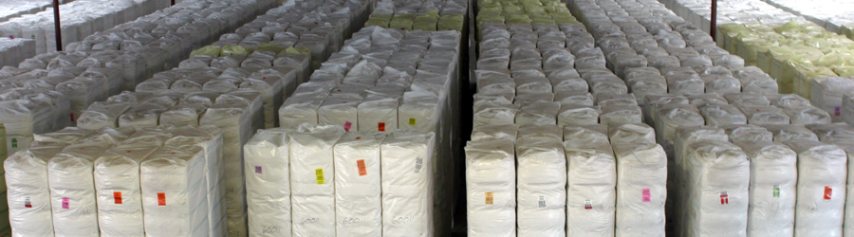
Similar Software Products
Plain Cotton Co-op Association vs Goodpasture Computer Service (1987)
Only literal copying of code was infringement

Slide 81
Similar Software Products
Computer Associates International vs Altai (1992)
Court decided by
Identify the purpose of the program
Remove from consideration the parts that are in the public domain, are common practice, or are the only efficient way of accomplishing some part
Compare the remaining parts and see how similar they are
Any particular case need expert witnesses and complex analysis of the program

